Slide 1
The Pythagorean Theorem
9th Grade Algebra

Slide 2
Goals and Objectives
Goal: Students will prove the pythagorean theorem by finding the area of the sides of a right triangle.
Students will discover that the area of the hypotenuse is equal to the sum of the areas of the two legs.
Objective: Given “Proving The Pythagorean Theorem,” the students will work in groups to determine the area of the sides of a right triangle for three consecutive trials.

Slide 3
Materials:
“Proving the Pythagorean Theorem” handout
Pen/Pencil
Notebook/Loose-leaf
Model of the triangles
Triangle 1, Triangle 2, and Triangle 3

Slide 4
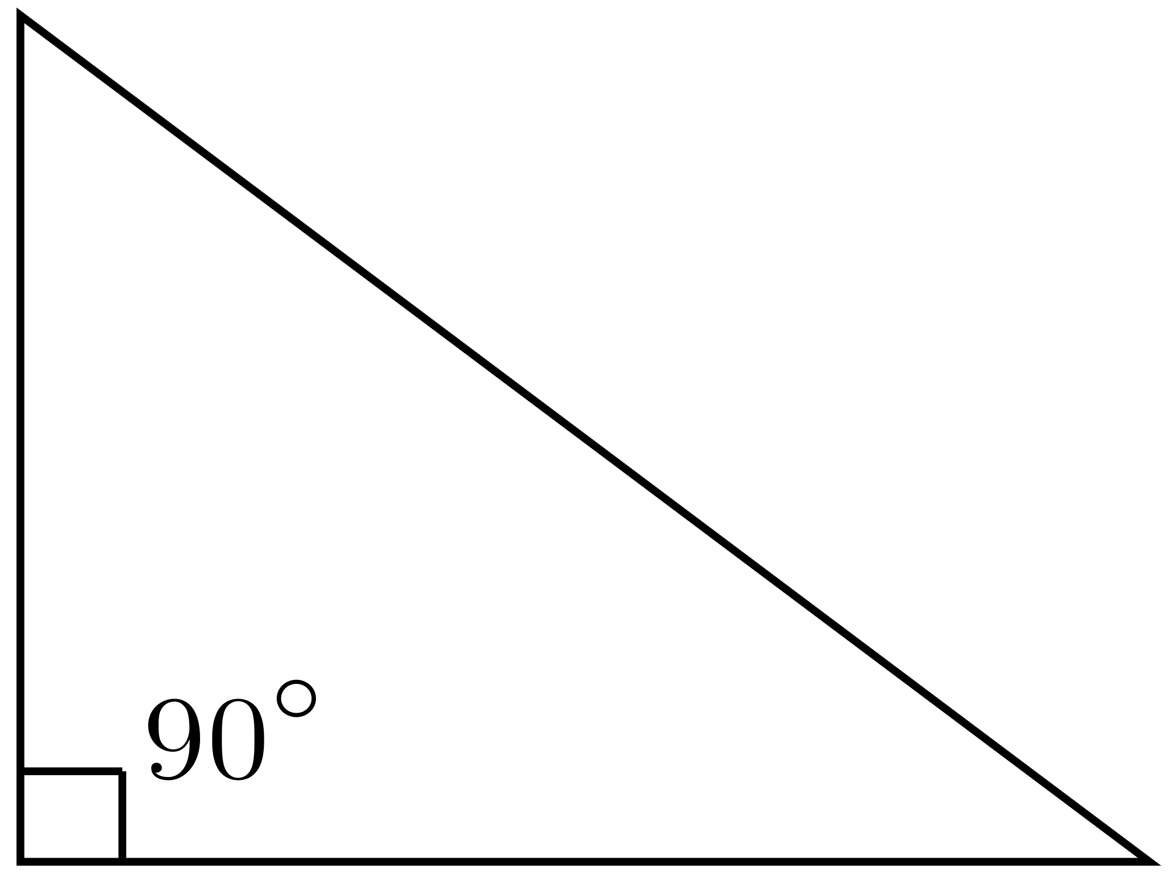
Terms to know:
Right Triangle: a triangle with a right angle (90 degrees).
Hypotenuse: the longest side of a right triangle, opposite the right angle.
Leg: either of the two shorter sides of a right triangle.

Slide 5
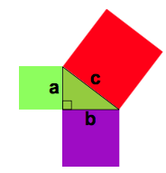
What is the pythagorean theorem?
When a triangle has a right angle (90 degrees) and squares are made on each of the three sides...then the biggest square has the exact same area as the other two squares put together!
It can be written in one short equation:
Note:
c is the longest side of the triangle
a and b are the legs
The area of a square is:

Slide 6
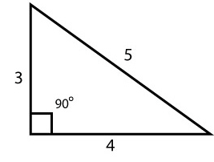
Look at this 3, 4, 5 triangle...
According to the Pythagorean Theorem,
In this triangle:
a=3
b=4
c=5
Does ?

Slide 7
Proving The Theorem:
Determine which side is the hypotenuse and which sides are the legs.
Line the starbursts along each side. How many starbursts did you use for each side?
Create a square on each side of the triangle.?
Calculate the area of each square.
Do the legs add up to equal the hypotenuse?

Slide 8
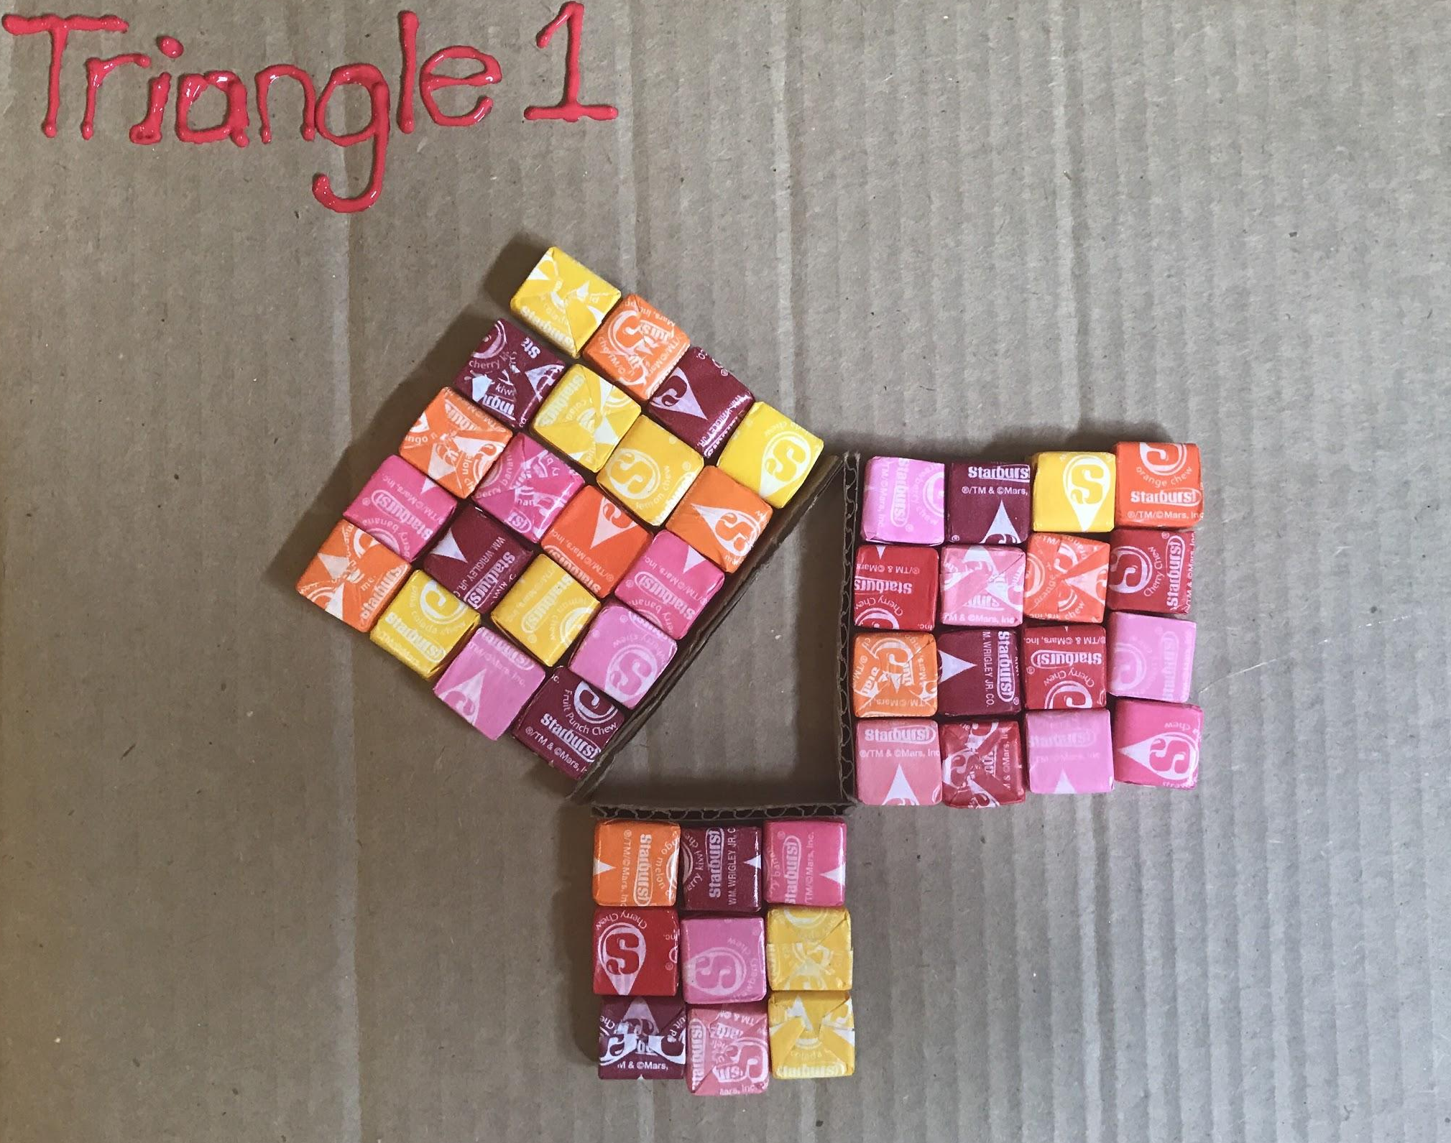
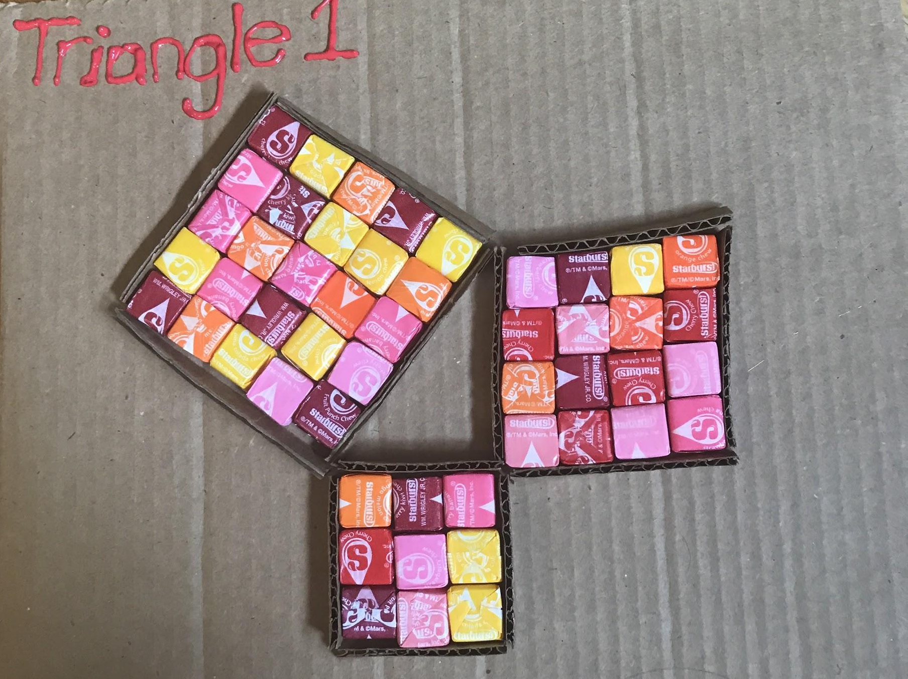
Triangle 1:

Slide 9
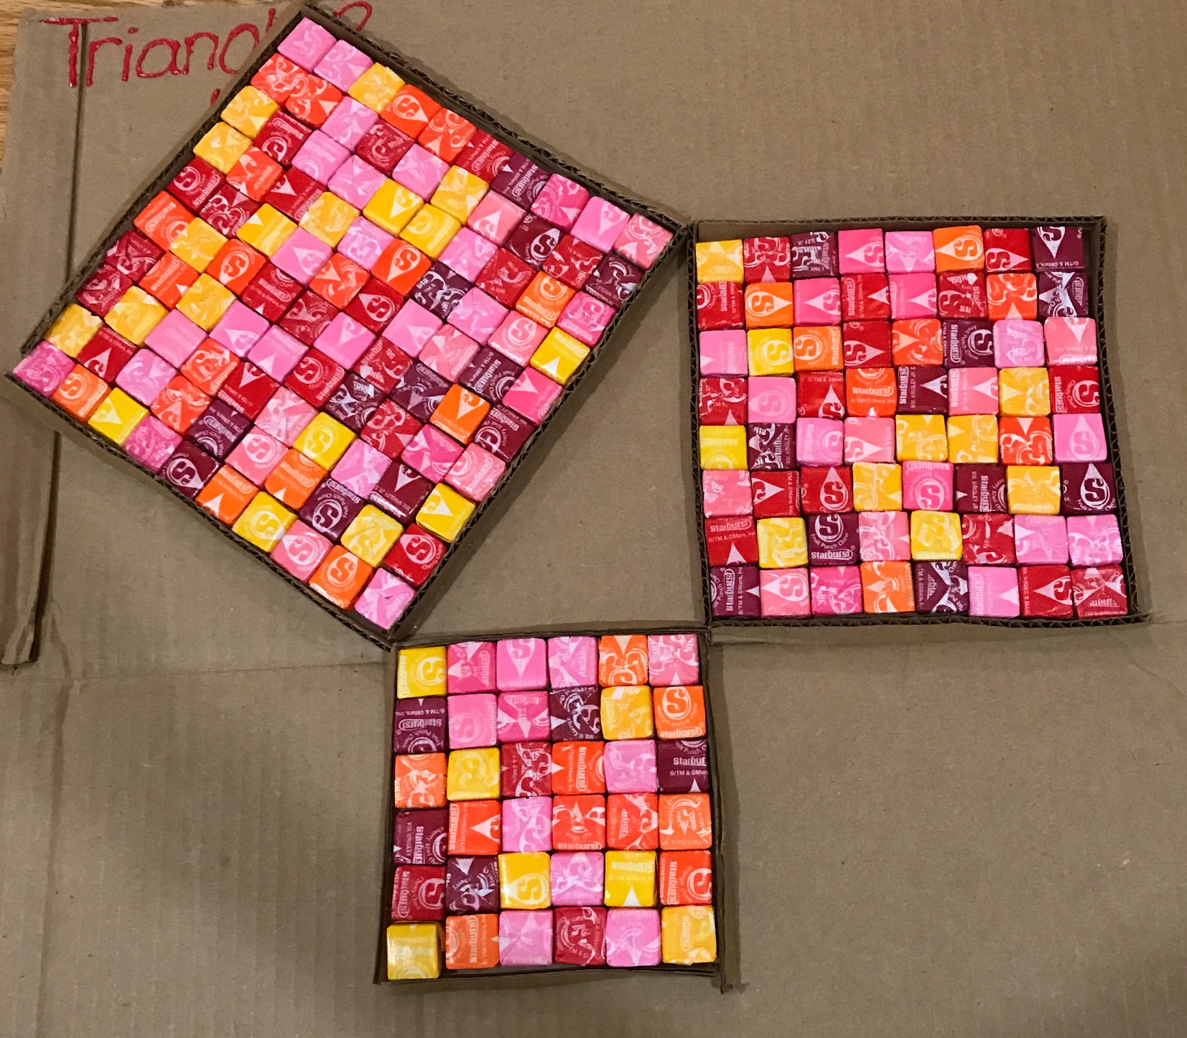
Triangle 2:

Slide 10
Triangle 3:

Slide 11
References:
Pythagoras' Theorem. (n.d.). Retrieved May 01, 2017, from https://www.mathsisfun.com/pythagoras.html
Bhardwaj, A. (2014, June 22). Pythagoras theorem project. Retrieved May 01, 2017, from
https://www.youtube.com/watch?v=X8X_Ckvul90

